Slide 1












Introduction to Robotic Process Automation
GENERATION OF EMPLOYEE ID AND EMAIL
Your Register No:220701132
Name:kiruthiga.M
Guide Name:Mrs.Jinu Shopia(M.E(Ph.D)
Designation :Assistant Professor
Department:CSE

Slide 2

Abstract
▪
In an organization, when new employees are onboarded, they require unique employee IDs and email addresses to access internal systems and communications. Currently, this process is manual, requiring HR or IT staff to create and assign IDs and emails for each employee. This automation aims to streamline the process by automatically generating these details based on predefined formats and employee information provided via an input file
Department of Computer Science and Engineering
Rajalakshmi Engineering College
2

Slide 3
Need for the Proposed System
Automation Efficiency: Reduces manual effort, saving time and minimizing human errors in generating employee IDs and emails.
Consistency: Ensures uniformity in ID and email formats, improving data quality and record management.
Scalability: Handles bulk employee data efficiently, which is essential for large organizations with frequent employee onboarding.
Integration: Automates the process of integrating with HR systems or databases for accurate employee data input.
Compliance: Helps maintain compliance with internal policies by following standardized procedures for ID and email creation.
Department of Computer Science and Engineering
Rajalakshmi Engineering College
3

Slide 4
Advantages of the Proposed System
Time Efficiency:Automates the manual process of generating employee IDs and emails, significantly reducing the time taken for onboarding new employees.
Error Reduction:Minimizes human errors in generating unique IDs and email addresses, ensuring consistency and accuracy.
Scalability:Can handle a large number of employee records efficiently, making it suitable for organizations of any size, especially those with frequent employee onboarding.
Cost-Effective:Reduces the need for manual intervention and administrative overhead, leading to cost savings in HR and IT departments.
Improved Data Management:Ensures standardized formats for employee IDs and emails, simplifying database management and improving data integrity.
Department of Computer Science and Engineering
Rajalakshmi Engineering College
4

Slide 5
Literature Survey
Overview:
The automation of employee ID and email generation using tools like UIPath is a practical approach that combines Robotic Process Automation (RPA) with data management techniques.
ADVANTAGES:
Efficiency
Accuracy
Scalability
Standardization
Cost Reduction
DISADVANTAGES:
Initial Setup Complexity
Dependency on Structured Input:
Error Propagation
Maintenance
Department of Computer Science and Engineering
Rajalakshmi Engineering College
5

Slide 6
Main Objective
▪
The objective of this project is to automate the generation of unique employee IDs and standardized email IDs using UiPath Studio. It aims to minimize manual effort, ensure accuracy, and follow predefined organizational rules. The solution integrates with existing HR databases, enhances onboarding efficiency, and provides scalability for future growth. Validation and error-handling mechanisms are implemented to ensure data consistency and reliability, delivering a streamlined and efficient process for employee data management
Department of Computer Science and Engineering
Rajalakshmi Engineering College
6

Slide 7
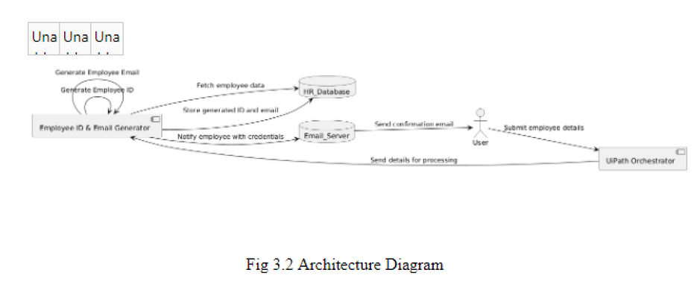
Architecture
Department of Computer Science and Engineering
Rajalakshmi Engineering College
7

Slide 8
System Requirements
Hardware Requirements:
Development (UiPath Studio)
Execution (UiPath Robot)
Production/Scaling
Software Requirements:
For UiPath Studio (Development Environment):
UiPath Studio: Latest version for designing automation workflows.
Windows 10 (64-bit) or later.
For UiPath Robot (Execution Environment):
UiPath Robot: To execute the automation workflows.
Windows 10 (64-bit) or later.
.
Department of Computer Science and Engineering
Rajalakshmi Engineering College
8

Slide 9
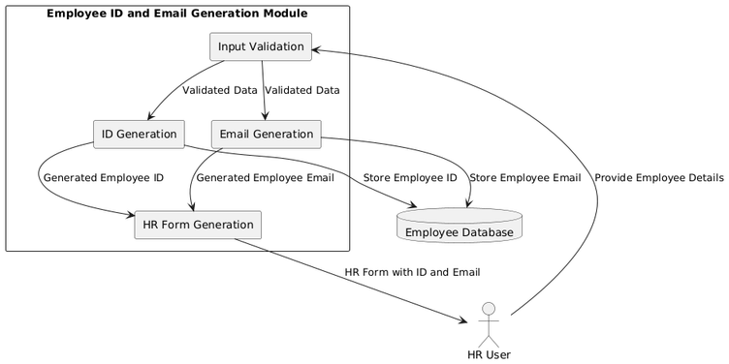
Functional Description
Module1:
Employee ID Generation Module:
Input: Employee's first name, last name, and any additional parameters (e.g., department).
Department of Computer Science and Engineering
Rajalakshmi Engineering College
9

Slide 10
Module2:
Employee Email Generation Module:
Input: Employee's first name, last name, and company domain name

Slide 11
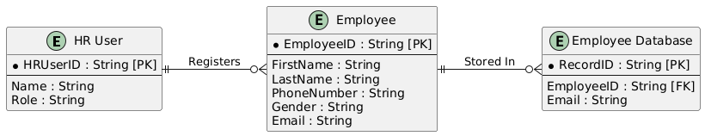
Table Design
ERD diagram:
Department of Computer Science and Engineering
Rajalakshmi Engineering College
10

Slide 12
Process Design
Main Process:
Data Collection
Generate Employee ID
Generate Employee Email
Update HR System/Database
Sub Process:
Data Input: Collect and validate employee data.
Generate Employee ID: Create a unique ID and check for duplicates.
Generate Employee Email: Create a unique email and check for conflicts.
Update HR System: Store the generated ID and email in the database.
Department of Computer Science and Engineering
Rajalakshmi Engineering College
11

Slide 13
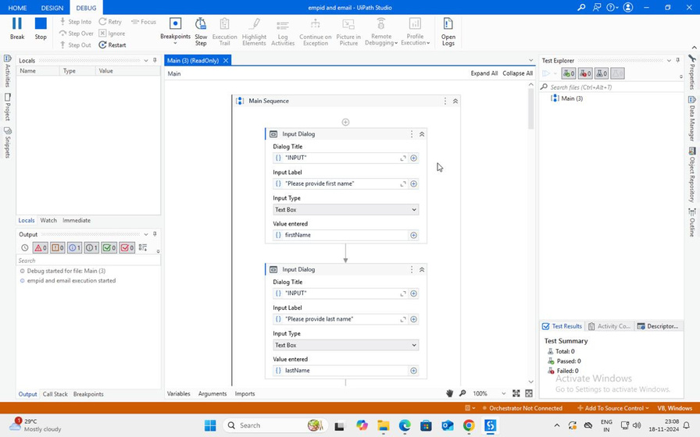
Implementation:
Department of Computer Science and Engineering
Rajalakshmi Engineering College
12

Slide 14
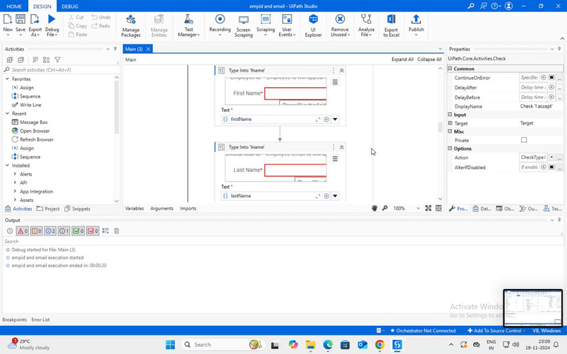
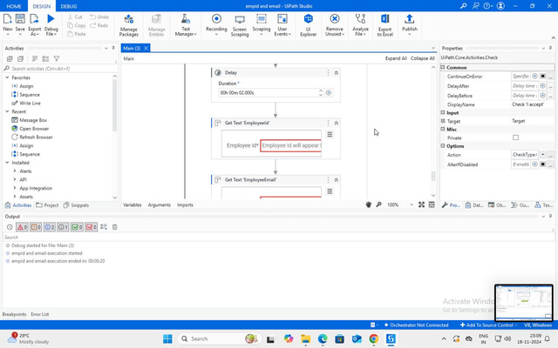

Slide 15
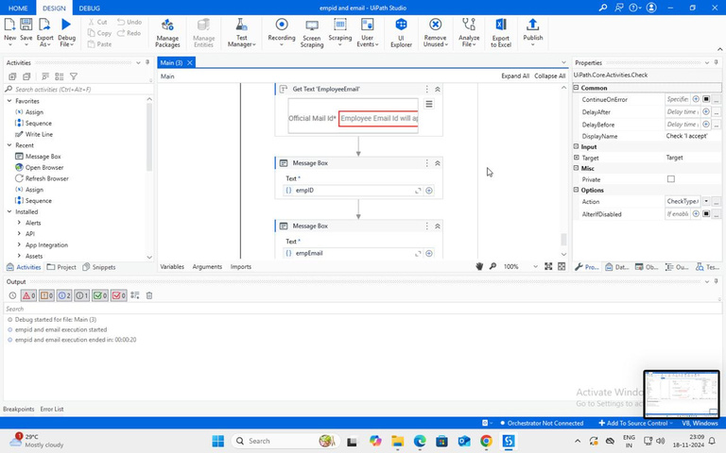

Slide 16
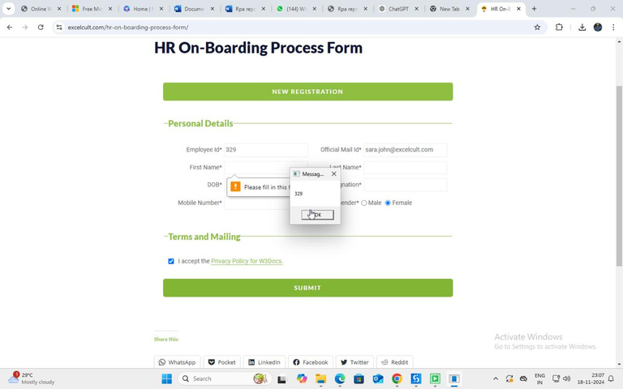
Testing
the output is displayed with emp-id and emp-mail
Output Screenshots:
Department of Computer Science and Engineering
Rajalakshmi Engineering College
13

Slide 17
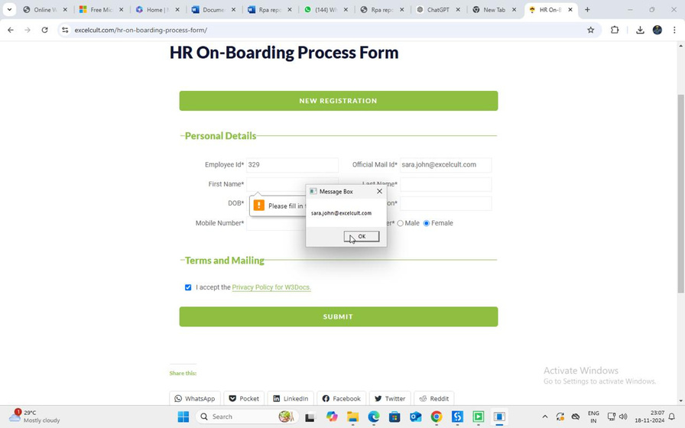

Slide 18
Conclusions
This UiPath automation project will save time and reduce errors during the employee onboarding process, improving both HR and IT efficiency. The generated Employee IDs and email addresses will be consistent, correctly formatted, and ready for use across the company's systems. The automation can be extended or modified in the future to incorporate additional fields or functionalities.
Department of Computer Science and Engineering
Rajalakshmi Engineering College
14

Slide 19
Future Enhancement
Integration with Cloud HR Systems
Dynamic Email Format Customization
Multi-Language Support
Self-Service Portal
Integration with Authentication Systems
Department of Computer Science and Engineering
Rajalakshmi Engineering College
15

Slide 20
IEEE Paper
Robotic Process Automation and Cognitive Automation: The Next Phase" by Mary C.
Lacity and Leslie P. Willcocks
"UiPath Studio: A Complete Guide for Beginners" by Gayan Dissanayake
Department of Computer Science and Engineering
Rajalakshmi Engineering College
16

Slide 21
References
▪
"Research Papers and Articles:
1. "Robotic Process Automation (RPA) in Human Resource Management"
2."Exploring the Future of Work: RPA and its Role in Streamlining Administrative
Department of Computer Science and Engineering
Rajalakshmi Engineering College
17

Slide 22

Thank You

